Slide 1
Cerebral Mechanisms of word masking and unconscious repetition priming
Stanislas Dehaene, Lionel Naccache, Laurent Cohen, Denis Le Bihan, Jean-Francois Mangin, Jean-Baptiste and Denis Rivie´re

Slide 2
Masking
A visible word flashed for only a few milliseconds remains readable
MASKING:
  When the same word is presented in close temporal proximity with other visual stimuli, it becomes indistinct and perceptually invisible

Slide 3
What makes masking interesting
Behavioral evidence indicates that the visual, orthographic & phonological properties can be extracted even without conscious perception of the stimuli.
Sometimes even meaning can be extracted.
Why this article?

Slide 4
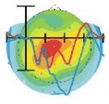

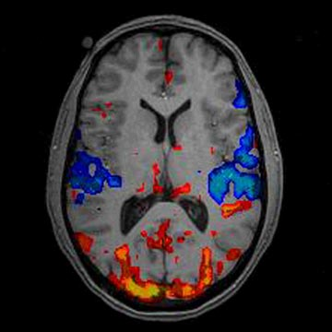
Why? ERP & fMRI
Temporal resolution
Spatial resolution
Yes, PJ! You can have the cake and eat it too …
Can I have the cake and eat it too?

Slide 5
ERP and fMRI specifics
ERP recordings: sampled at the rate of 125 Hz with 128-electrode geodesic sensor net-referenced to the vertex.
Imaging: 3T whole-body system; gradient-echo echo-planar imaging sequence (high data acquisition rate); BOLD contrast

Slide 6
Experiment I
Goal: To image areas activated by masked words within the circuit for word processing. Compare this with ERP data.

Slide 7
Materials
Mask: semi-random arrangement of diamonds and square shapes in the center with the same line thickness as words.
3 lists of 37 four letter nouns
    Masked
    Unmasked
    Distracters
Four stimulus types: visible words, visible blanks, masked words, masked blanks

Slide 8
Methods
Stimuli were grouped into 2400 ms long trials comprising of 4 of the same type presented with an interval of 500ms.
Rest of the trial randomly filled with blanks and masks.
Why?
  Succession of trials gave a subjective impression of continuous stream of masks with words flashing at random.

Slide 9
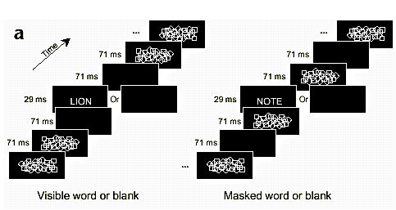
EXPT 1 DESIGN

Slide 10
Participants
French students 19 to 34 years old
ERP: 6 men and 6 women
fMRI: 3 men and 12 women

Slide 11
Data Collection
Imaging: during 5 streams of trials
  A stream:
    5 leading blanks
    30 trials of each type
    lasting 5 mins
Behavioral tests before and after imaging
  naming/detection
  naming/detection; recognition; forced choice tasks

Slide 12
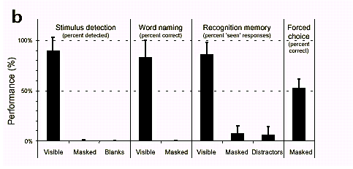
Behavioral Results

Slide 13
Behavioral results
Masked words could not be detected, named or remembered.
Naming/Detection:
  Visible words: 90.2% detected; 88.9% correctly named (of detected)
  Masked words: 0.7% detected (slightly more than the false alarm rate of 0.2%, p = 0.02); only one was ever named

Slide 14
Behavioral results
Recognition task:
  85.9 % of visible words were recognized
  7.1 % of masked words were recognized
  6.0 % of distracters were recognized
  No significant difference between masks and distracters for both RT and accuracy
Forced Choice task: 52.9 % just above 50% chance.

Slide 15
Imaging results
Visible words:
  left fusiform gyrus, precentral cortex
  left parietal cortex
  bilateral inferior prefrontal/anterior insular cortex
  Anterior cingulate
  similar to word reading network found in PET
    except for absence of anterior inferior temporal areas
    signal loss in fMRI
Masked words:
  In the above circuit: left fusiform gyrus, left extrastriate cortex and left precentral sulcus
Overall activation was reduced for masked words:
  left extrastriate cortex: 19%
  left fusiform cortex: 8.6%
  left precentral cortex: 5.2%

Slide 16
Imaging Results

Slide 17
ERP Results
P1:
  early evoked sensory response
  positive wave over the occipital scalp; average latency ~ 100ms
  reflects the automatic detection of stimulus in primary visual cortex
Visible words: peak at 164 ms
Mask words: peak 180 ms; delayed and smaller compared to Visible words

Slide 18
ERP Results
N1:
  early evoked sensory response
  negative wave over the occipitotemporal scalp; average latency ~ 100ms
  reflects aspects of attention?
  Visible words: peak at 252ms; posterior in distribution
  Masked words: Left N1 (LAN?): Left anterior in distribution; prolonged
N400 & P3
  Visible words: Yes
  Masked words: No

Slide 19
ERP Topological maps

Slide 20
Overall
Image unconscious activity induced by isolated unseen words
  Early occipital waveform (170ms) plausibly corresponding to extrastriate activation seen in fMRI
  Two subsequent negative left lateralized ERP components (240 & 470 ms) may correpond to left fusiform and precentral activations seen in fMRI

Slide 21
Problems with Experiment I
Does not asses the specificity of masked words.
Difference between masked words and masked blanks may merely reflect the permeation of a cerebral reading circuits by small non-specific activity independent of particular stimulus shown without any direct relation to priming

Slide 22
Experiment II
Goal: To show that masked words caused repetition priming

Slide 23
Materials and Methods
40 5-letter imageable French nouns with frequency higher than 10 million were selected. Half man made (train) and half natural (fruit)
Each trial consists of masked prime (29ms) and visible target (500 ms)
  Visible target either same as prime or different (both belonged to different category when they were different with no letters common in any location)
  Visible target either same or different case as prime

Slide 24
Materials, methods and Participants
Subjects were asked to make manmade /natural judgments
Baseline: masked primes with no target
Imaging: imaged in 4 sessions of 150 trials each.
Behavioral forced choice tests after imaging
3 men and 7 women

Slide 25
Design Expt II

Slide 26
Repetition Suppression
The prediction was repetition suppression for masked words when the primes and targets were the same.
Repetition suppression: Phenomenon of reduced activation in word processing when same word was presented twice
Crucially design allows us to extract areas of repetition that are independent of the case.

Slide 27
Behavioral Results
Participants denied seeing the primes and were unable to select them in two-alternative forced choice test (53.6%; p>0.10)
Reaction times during imaging were significantly shorter when prime and target were the same word independent of case

Slide 28
Behavioral Results

Slide 29
Imaging Results
Case-Independent Priming:
  Within the word processing circuit, significant repetition suppression was observed in left fusiform gyrus
  Case-independent priming also found in left precentral gyrus and in symmetrical right precentral region
Case-dependent priming restricted to same-case trials was observed in two right extrastriate regions
  In both regions repetition with case change interaction was significant

Slide 30
Imaging Results

Slide 31
Discussion
Reduced activation in left fusiform, right extrastriate and precentral regions shows that masked words exhibit repetition priming and hence is not a mere visual burst
Specific information about the word identity must be extracted in left fusiform and precentral regions

Slide 32
Discussion
Left lateralization of the left fusiform activation can be tied to left hemisphere specialization in extracting shape independent features of the words.
Right extrastriate region might be involved in coding visual features of the word and hence is case-specific.
Right lateralization is debatable since symmetrical activation was found at lower levels in the left.

Slide 33
Take Home
Reduced activation for masked words compared to visible words.
  Competition
  failure to amplify short lived bottom-up signal by top-down signals.
Increased activity at distant parietal, prefrontal and cingulate sites for visible words: Highly intercorrelated sites.
P300 to visible words only: updating of conscious and so multiple distant sites are synchronously activated.
Repetition priming regions for masked words

Slide 34
Questions?

